Slide 1
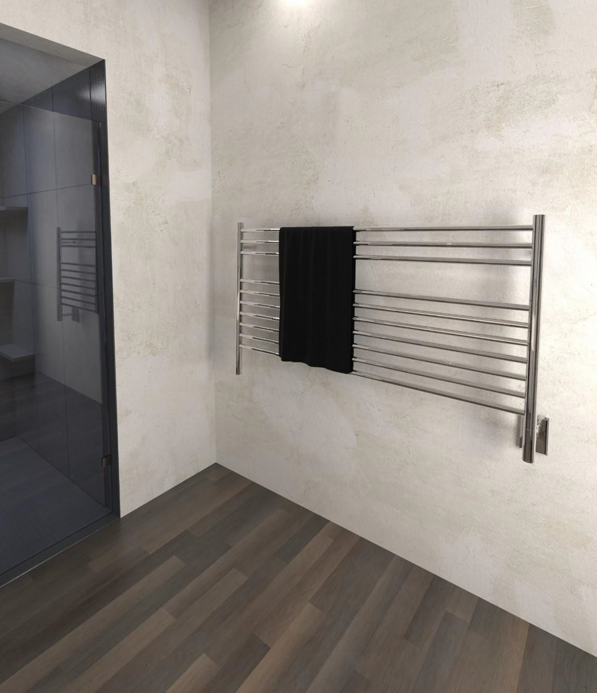




Heated Towel Racks:
• About the Instructor • About the Sponsor • Ask an Expert
Design and Function for Interior Spaces
This Online Learning Seminar is available through a professional courtesy provided by:
Amba Products
790 Pickens Industrial Drive Marietta, GA 30062
Tel: 404-350-9738
Fax: 404-355-0166
Email: customerservice@ambaproducts.com Web: www.ambaproducts.com
START
powered by
©2019 Amba Products. The material contained in this course was researched, assembled, and produced by Amba Products and remains its property. Questions or concerns about the content of this course should be directed to the program instructor. This multimedia product is the copyright of AEC Daily.
©2019
∙ Table of Contents
Slide 1 of 83

Slide 2

About the Instructor
Heated Towel Racks:
About the Sponsor
Ask an Expert
Design and Function for Interior Spaces
To ensure the current status of this course, including relevant association approvals, please view the course details here.
The American Institute of Architects Course No. AEC1348
This program qualifies for 1.0 LU/HSW Hour
Course Expiry Date: 12/05/2022
AEC Daily Corporation is a registered provider of AIA-approved continuing education under Provider Number J624. All registered AIA CES Providers must comply with the AIA Standards for Continuing Education Programs. Any questions or concerns about this provider or this learning program may be sent to AIA CES (cessupport@aia.org or (800) AIA 3837, Option 3).
This learning program is registered with AIA CES for continuing professional education. As such, it does not include content that may be deemed or construed to be an approval or endorsement by the AIA of any material of construction or any method or manner of handling, using, distributing, or dealing in any material or product.
AIA continuing education credit has been reviewed and approved by AIA CES. Learners must complete the entire learning program to receive continuing education credit. AIA continuing education Learning Units earned upon completion of this course will be reported to AIA CES for AIA members. Certificates of Completion for both AIA members and non-AIA members are available upon completion of the test.
©2019 ∙ Table of Contents

Slide 3
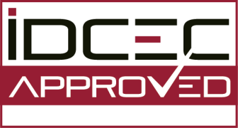
About the Instructor
About the Sponsor
Ask an Expert
This CEU is registered with the Interior Design Continuing Education Council (IDCEC) for continuing education credits. This credit will be accepted by the American Society of Interior Designers (ASID), International Interior Designers Association (IIDA) and Interior Designers of Canada (IDC).
The content included is not deemed or construed to be an approval or endorsement by IDCEC of any material or construction or any method or manner of handling, using, distributing or dealing in any material or product.
Questions related to specific materials, methods and services should be directed to the instructor or
provider of this CEU.
This program is registered for 0.1 CEU value. The IDCEC class-code is: CC-110460-1000.
This CEU will be reported on your behalf to IDCEC and you will receive an email notification. Please log in and complete the electronic survey for this CEU.
Certificates of completion will be automatically issued once you have submitted the online survey for
this CEU.
Attendees who do not belong to ASID, IIDA or IDC and do not have a unique IDCEC number will be provided with a Certificate of Completion after this CEU.
©2019 ∙ Table of Contents

Slide 4

About the Instructor
About the Sponsor
Ask an Expert
AEC Daily Corporation has met the standards and requirements of the Registered Continuing Education Program. Credit earned on completion of this program will be reported to RCEP at RCEP.net.
A certificate of completion will be issued to each participant. As such, it does not include content that may be deemed or construed to be an approval or endorsement by the RCEP.
©2019 ∙ Table of Contents

Slide 5
About the Instructor
About the Sponsor
Ask an Expert
Purpose and Learning Objectives
Purpose:
Heated towel racks not only warm and dry damp towels, but also add a sense of comfort and luxury. This course explores heated towel racks and includes discussions on: the functions, benefits, and applications of heated towel racks; centrally heated, electric, and hydronic heating systems; materials and finishes; installation and care; and, design and accessory options.
Learning Objectives:
At the end of this program, participants will be able to:
identify the various functions and applications of heated towel racks and differentiate
between centrally heated, electric, and hydronic heating systems
discuss how heated towel racks are an energy-efficient heat source, contribute to water saving measures, and improve indoor air quality by mitigating mold and mildew growth
list the benefits of designing with stainless steel, and explain how it contributes to sustainable design objectives, and
outline key measures that must be followed during the installation of a heated towel
rack to ensure a safe and secure installation, preventing the risk of electrocution.
©2019 ∙ Table of Contents

Slide 6
About the Instructor
About the Sponsor
Ask an Expert
How to Use This Online Learning Course
To view this course, use the arrows at the bottom of each slide or the up and down arrow
keys on your keyboard.
To print or exit the course at any time, press the ESC key on your keyboard. This will minimize the full-screen presentation and display the menu bar.
Within this course is a test password that you will be required to enter in order to proceed with the online test. Please be sure to remember or write down this test password so that you have it available for the test.
To receive a certificate indicating course completion, refer to the instructions at the end of
the course.
For additional information and post-seminar assistance, click on any of the logos and icons within a page or any of the links at the top of each page.
©2019 ∙ Table of Contents

Slide 7
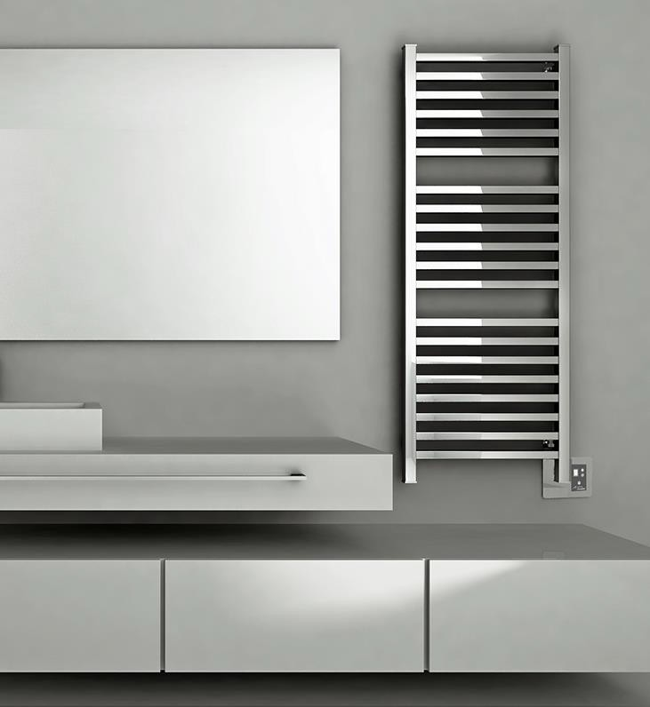
About the Instructor
About the Sponsor
Ask an Expert
Contents
Heated Towel Rack Designs
Functions, Benefits, and Applications Methods of Heating Unit
Safety Measures
Materials and Finishes Accessories
Summary
Resources
Click on title to view
©2019 ∙ Table of Contents

Slide 8
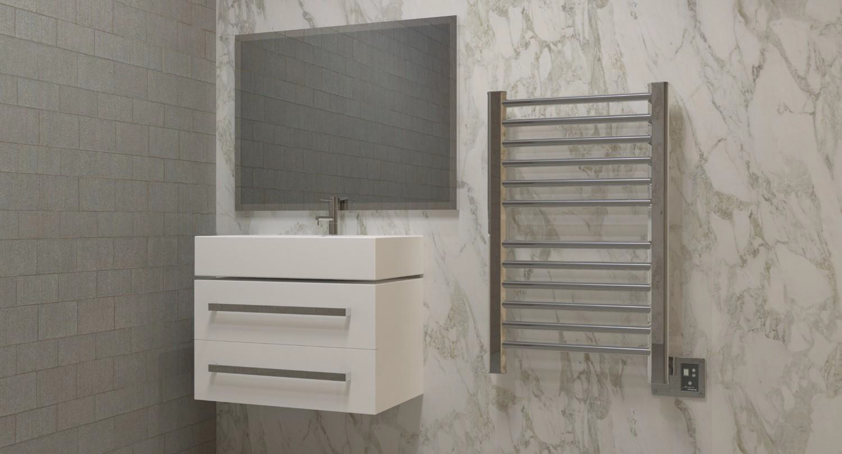
About the Instructor
About the Sponsor
Ask an Expert
Heated Towel Rack Designs
©2019 ∙ Table of Contents

Slide 9
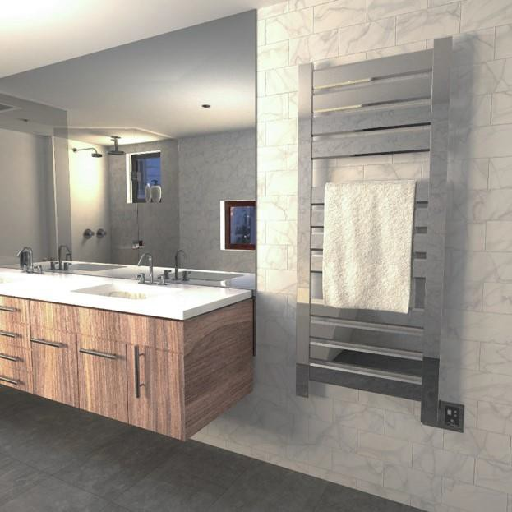
About the Instructor
About the Sponsor
Ask an Expert
Design Options
Many manufacturers will offer a variety of designs, sizes and finishes, in either electric or hydronic versions. As such, there should be a product available to suit any style and budget.
There will be choices available in the size of
the unit, number of bars, and bar spacing. Some manufacturers will even offer custom design and color options. When selecting a unit, the two most important factors are the surface area (number of bars) and the power output (wattage). Custom designs can be aesthetically pleasing (single-bar designs, etc.), but less functional than a traditional heated towel rack. In general, they will project about four to six inches away from the wall and some can be adjusted.
©2019 ∙ Table of Contents

Slide 10
About the Instructor
About the Sponsor
Ask an Expert
Design Options
Depending on the manufacturer and the unit, a cover plate may be included with an integrated on/off switch with a pilot light. Some units can be controlled by a 24-hr/7-day programmable or countdown timer, or even by a digital heat controller that allows for different heat settings. Some units have a built-in thermostat for optimal energy consumption and safety. Smart timers and app-driven controls can be useful in setting schedules and adding a heated towel rack to a connected smart-home. Source a manufacturer whose units meet all current safety standards.
The following slides showcase some heated towel rack designs, show the variations that are often available within the design, and list some common features of similar units.
©2019 ∙ Table of Contents

Slide 11
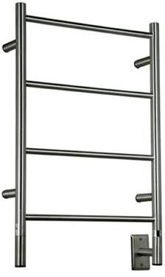
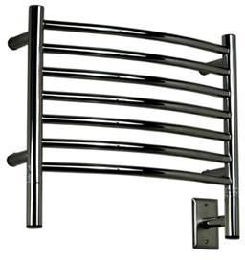
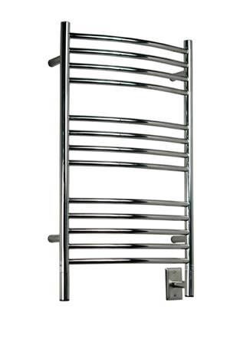
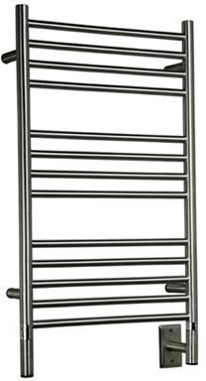
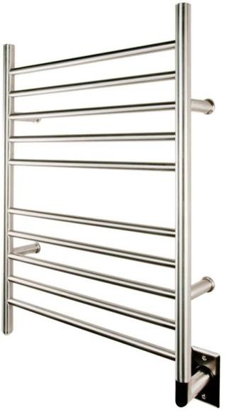
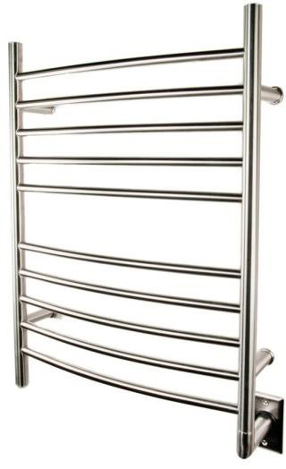
About the Instructor
About the Sponsor
Ask an Expert
Classic Design
Classic towel bar design
Straight bars or curved bars
Bar spacing accommodates both small and large towels
Liquid or cable heating system
©2019 ∙ Table of Contents

Slide 12
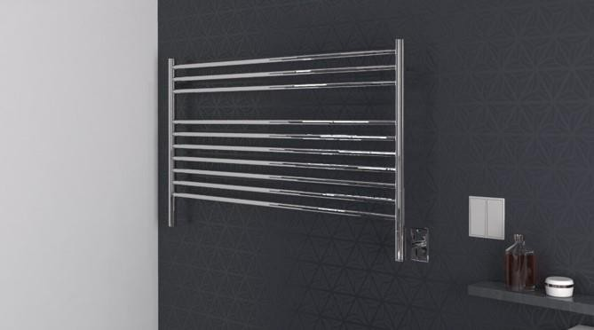
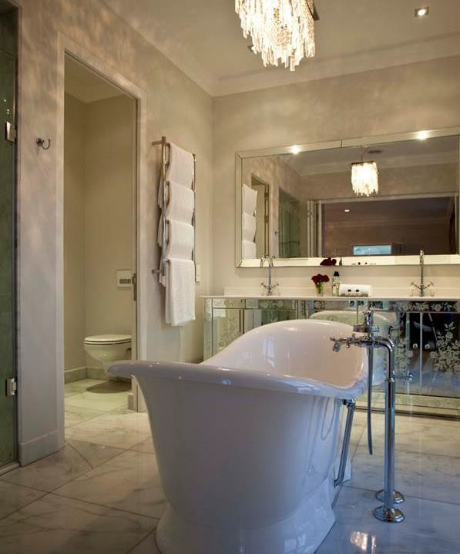
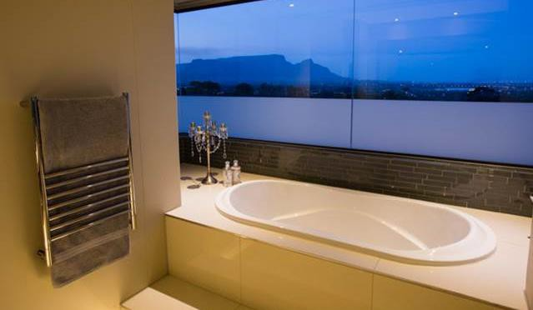
About the Instructor
About the Sponsor
Ask an Expert
Classic Design
©2019 ∙ Table of Contents

Slide 13
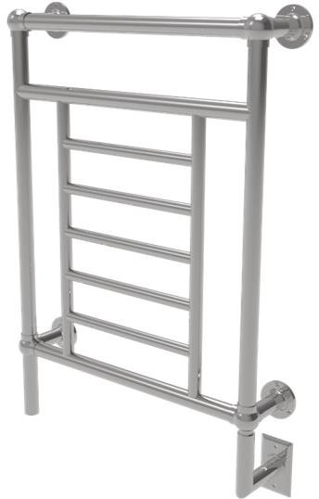
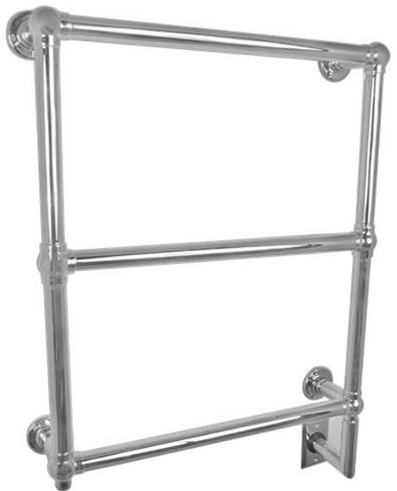
About the Instructor
About the Sponsor
Ask an Expert
Edwardian Design
Rounded bars with finials at each corner
Crafted finials and pipes
Suitable for draping large towels and bathrobes
©2019 ∙ Table of Contents

Slide 14
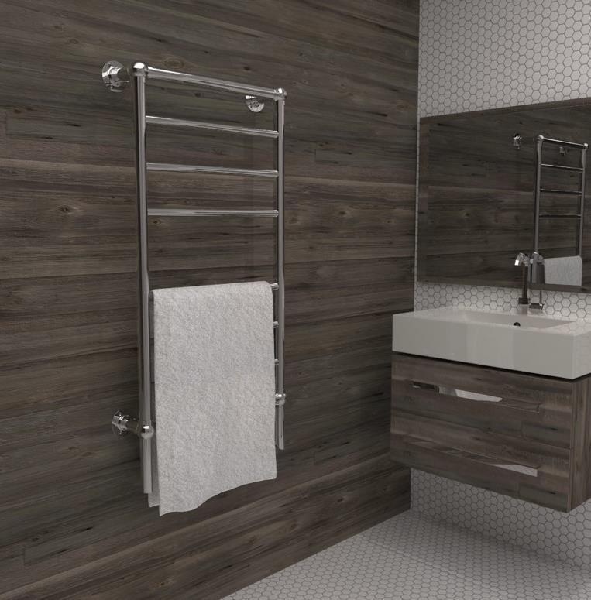
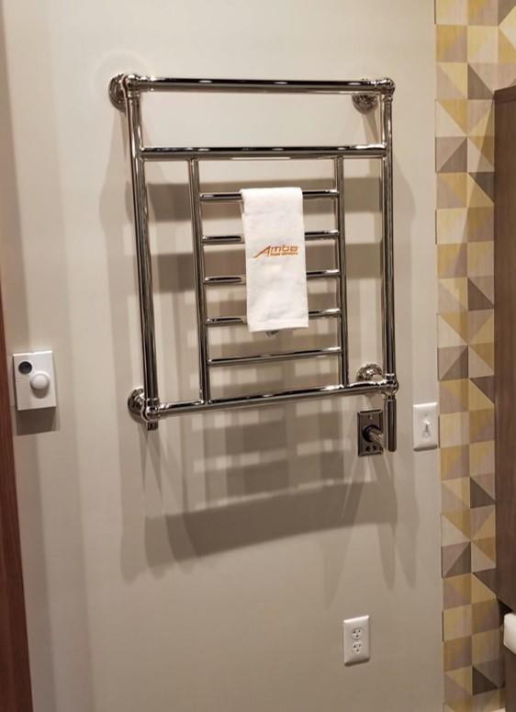
About the Instructor
About the Sponsor
Ask an Expert
Edwardian Design
©2019 ∙ Table of Contents

Slide 15
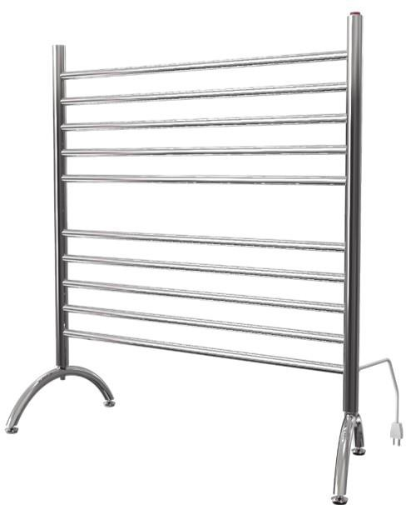
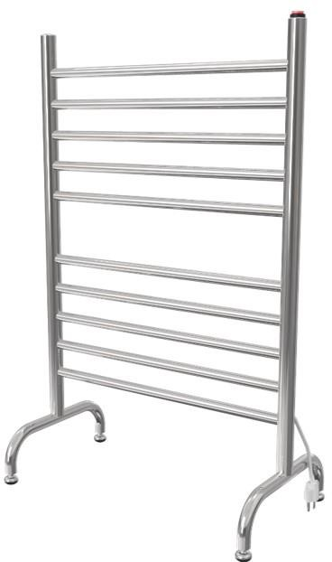
About the Instructor
About the Sponsor
Ask an Expert
Freestanding Design
No installation required
Plugs into any standard outlet
Portable
Energy efficient
No-liquid system
Saves space
©2019 ∙ Table of Contents

Slide 16
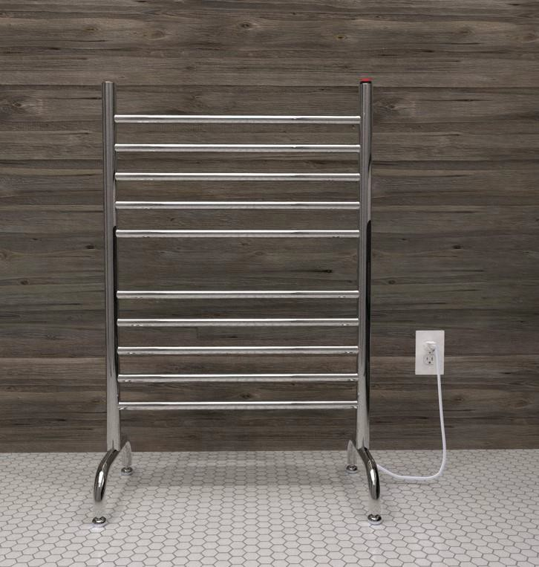
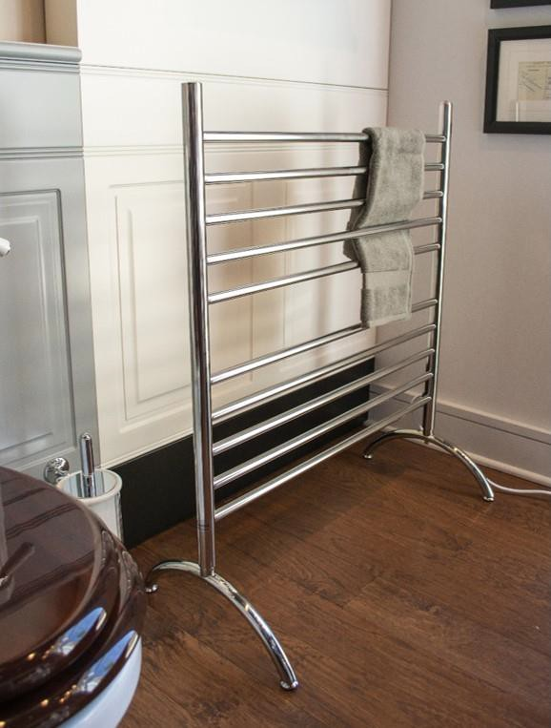
About the Instructor
About the Sponsor
Ask an Expert
Freestanding Design
©2019 ∙ Table of Contents

Slide 17
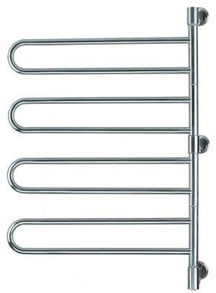
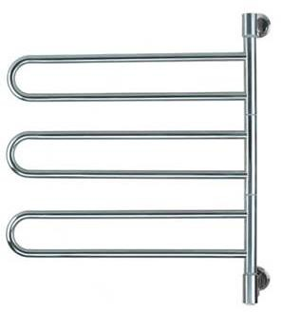
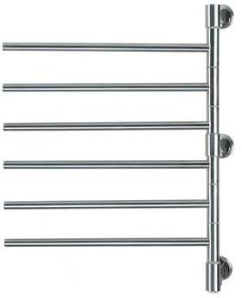
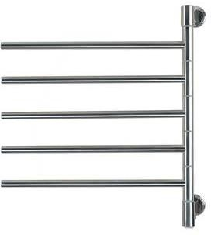
About the Instructor
About the Sponsor
Ask an Expert
Rotating Arm Design
Swivel hinge rotates 180 degrees
Each arm moves independently
Simple to install
Energy efficient
No-liquid system
Saves space
©2019 ∙ Table of Contents

Slide 18
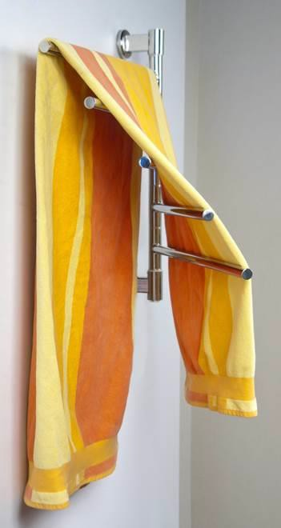
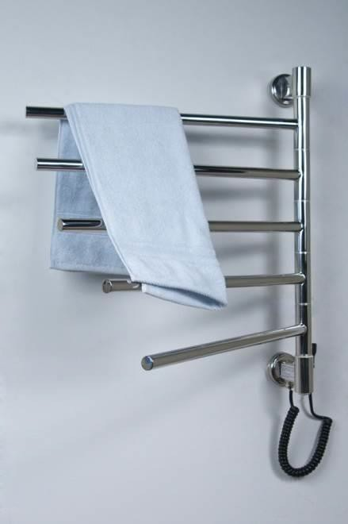
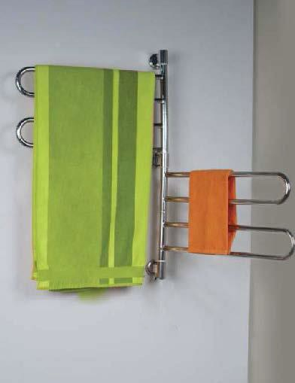
About the Instructor
About the Sponsor
Ask an Expert
Rotating Arm Design
©2019 ∙ Table of Contents

Slide 19
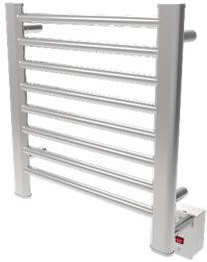
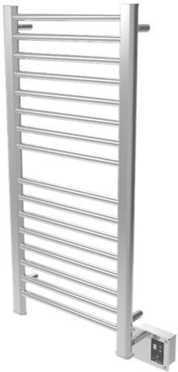
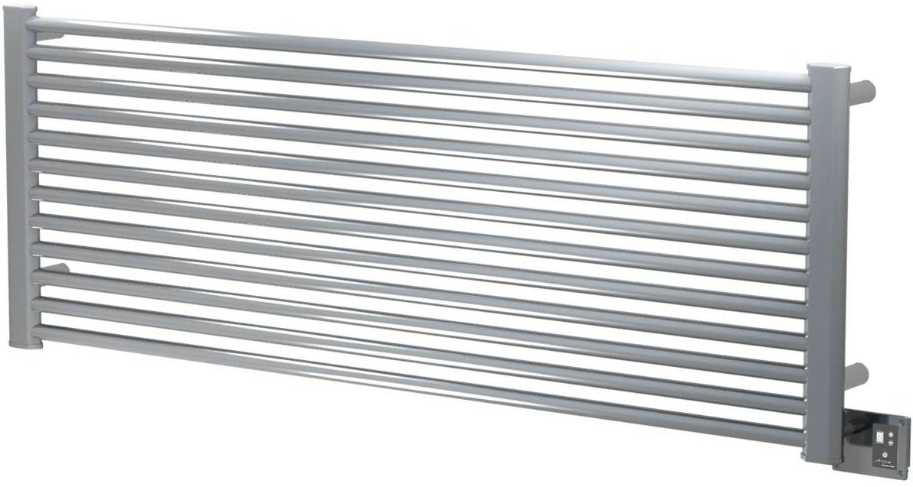
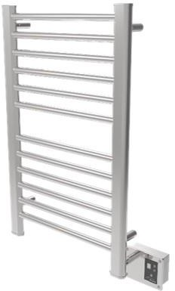
About the Instructor
About the Sponsor
Ask an Expert
Narrow Bar Design
Supports additional towel bars or robe hooks
Suitable for drying large towels and bathrobes
Larger models can supply supplemental heat to a room
Silent and energy efficient—heats quickly and evenly
Flexible design allows for unit to be installed vertically,
horizontally, or upside down
No-liquid system
©2019 ∙ Table of Contents

Slide 20
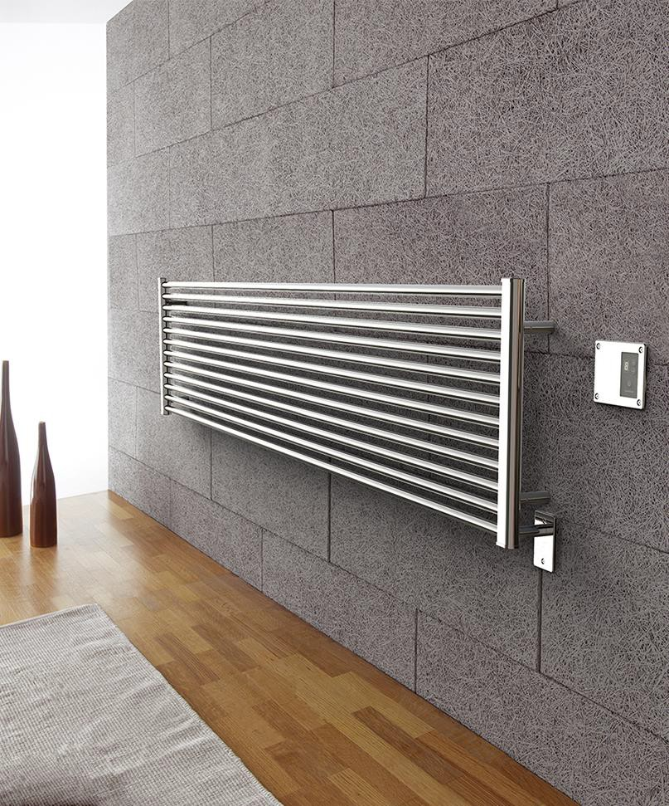
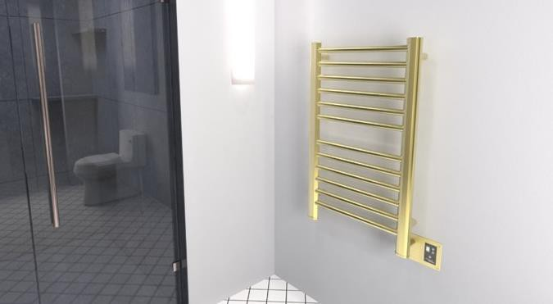
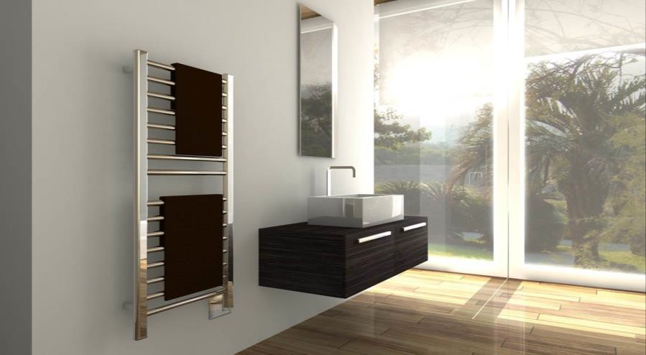
About the Instructor
About the Sponsor
Ask an Expert
Narrow Bar Design
©2019 ∙ Table of Contents

Slide 21
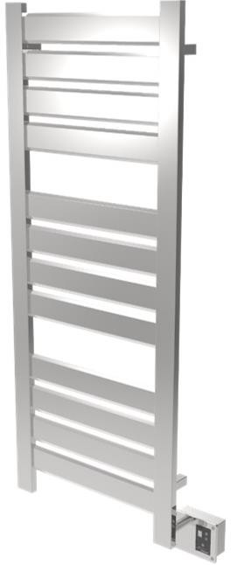
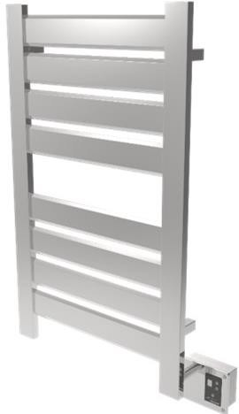
About the Instructor
About the Sponsor
Ask an Expert
Broad Bar Design
Broad and flat panels warm towels quickly
and evenly
Large models can supply supplemental heat to a room
Suitable for drying large towels and bathrobes
Flexible design allows for unit to be installed vertically, horizontally, or upside down
No-liquid system
©2019 ∙ Table of Contents

Slide 22
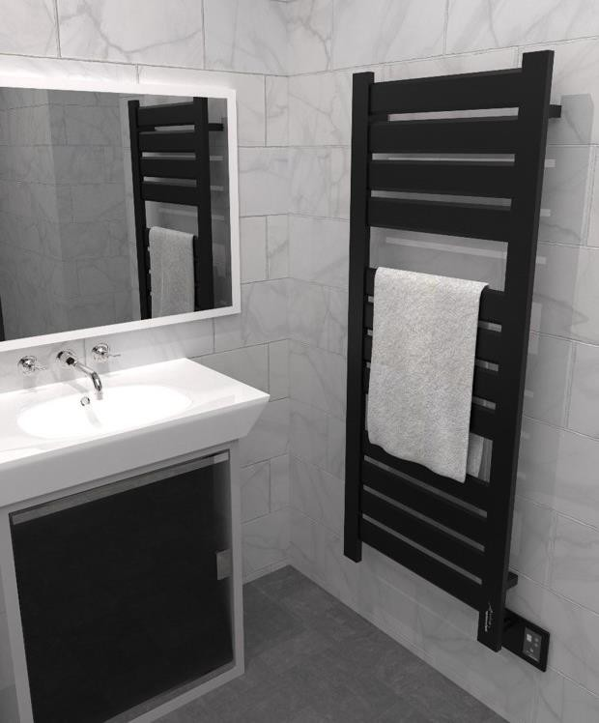
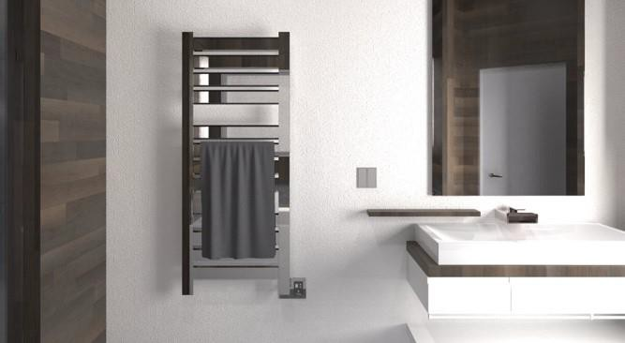
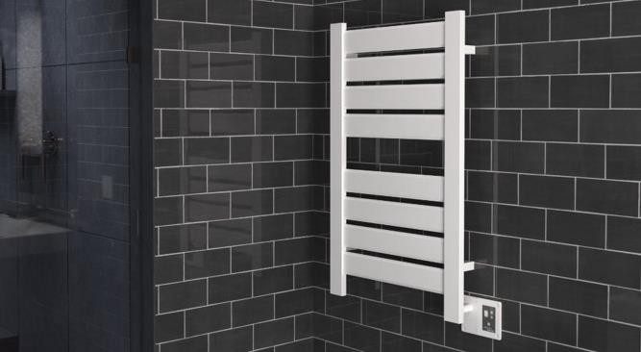
About the Instructor
About the Sponsor
Ask an Expert
Broad Bar Design
©2019 ∙ Table of Contents

Slide 23
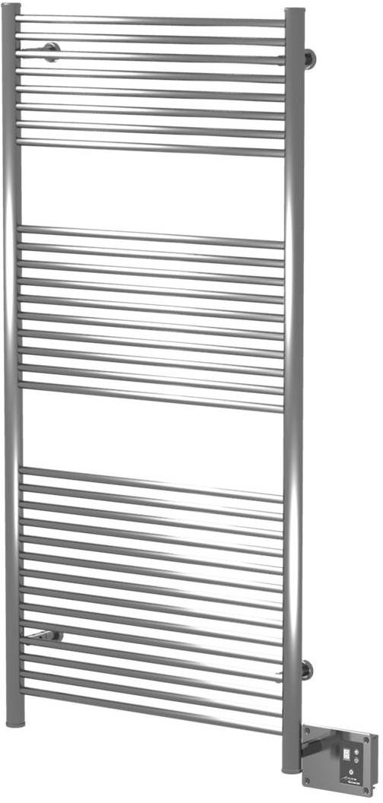
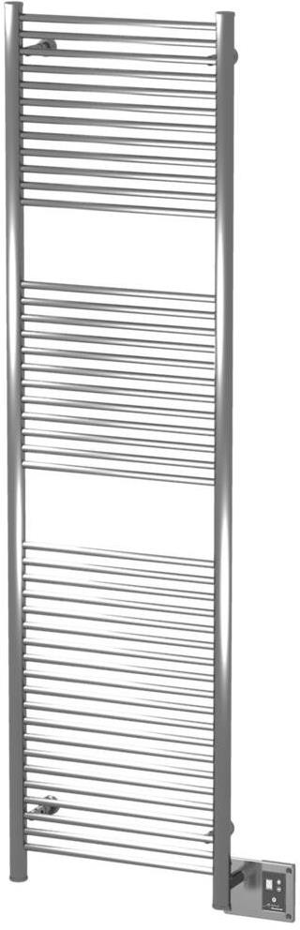
About the Instructor
About the Sponsor
Ask an Expert
Long Bar Design
Long bars provide space for large,
thick towels
Suitable for drying large towels and bathrobes
Large models can supply supplemental heat to a room
Flexible design allows for unit to be installed vertically, horizontally, or upside down
No-liquid system
©2019 ∙ Table of Contents

Slide 24
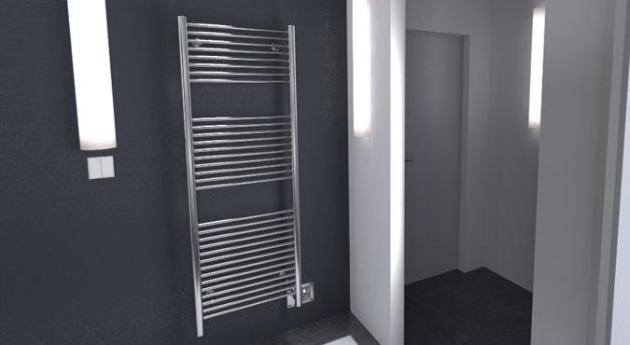
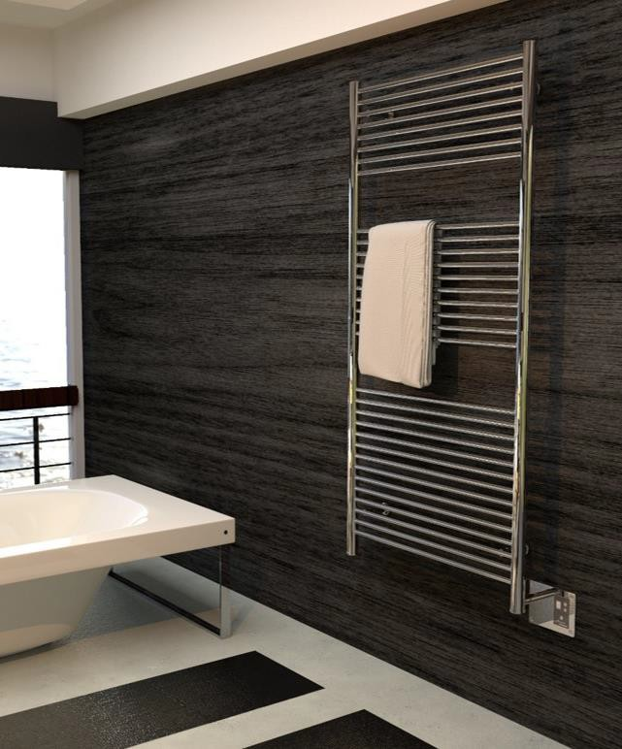
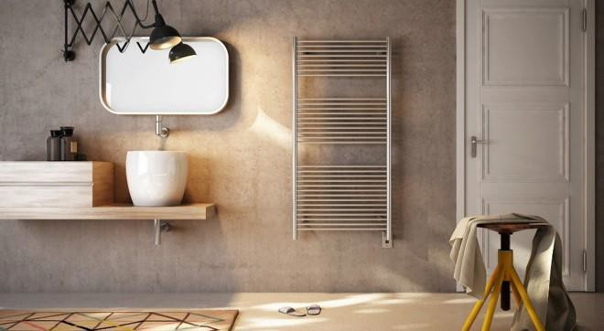
About the Instructor
About the Sponsor
Ask an Expert
Long Bar Design
©2019 ∙ Table of Contents

Slide 25
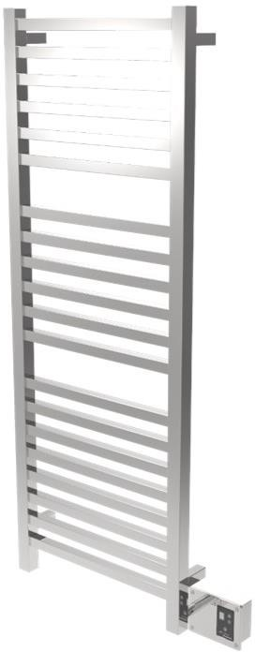
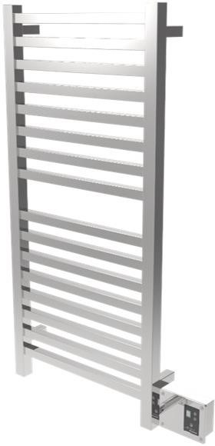
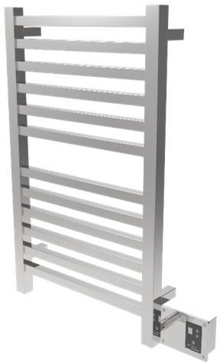
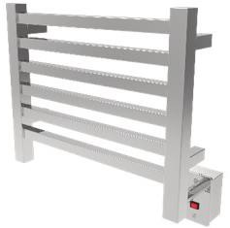
About the Instructor
About the Sponsor
Ask an Expert
Square Bar Design
Flexible design allows for unit to be installed vertically, horizontally or upside down
Larger models can supply supplemental heat to a room
Large, square bars for even heating
Suitable for drying large towels and bathrobes
Heats quickly
No-liquid system
©2019 ∙ Table of Contents

Slide 26



About the Instructor
About the Sponsor
Ask an Expert
Square Bar Design
©2019 ∙ Table of Contents

Slide 27


About the Instructor
About the Sponsor
Ask an Expert
Flat Panel Design
Single-panel
Silent and energy efficient—heats up quickly and evenly
Larger models can supply supplemental heat to a room
Innovative, discreet design complements a variety of contemporary bathroom styles
Large, flat heating surface area—suitable for drying large, thick towels
No-liquid system
©2019 ∙ Table of Contents

Slide 28



About the Instructor
About the Sponsor
Ask an Expert
Flat Panel Design
©2019 ∙ Table of Contents

Slide 29



About the Instructor
About the Sponsor
Ask an Expert
Custom Designs
©2019 ∙ Table of Contents

Slide 30



About the Instructor
About the Sponsor
Ask an Expert
Custom Designs
©2019 ∙ Table of Contents

Slide 31





About the Instructor
About the Sponsor
Ask an Expert
Custom Colors
©2019 ∙ Table of Contents

Slide 32
About the Instructor
About the Sponsor
Ask an Expert
REVIEW QUESTION
List some of the features of the heated towel rack design pictured here.
©2019 ∙ Table of Contents

Slide 33
About the Instructor
About the Sponsor
Ask an Expert
ANSWER
Rotating Arm Design
Swivel hinge rotates 180 degrees
Each arm moves independently
Simple to install
Energy efficient
No-liquid system
Saves space
©2019 ∙ Table of Contents

Slide 34

About the Instructor
About the Sponsor
Ask an Expert
Functions, Benefits, and Applications
©2019 ∙ Table of Contents

Slide 35

About the Instructor
About the Sponsor
Ask an Expert
History of the Heated Towel Rack
The origin of the heated towel rack is found in the invention of the “radiator,” which is said to have been invented in St. Petersburg, Russia in about 1855.
The radiator forms part of a central heating system whereby a boiler heats water, which is pumped through a series of pipes in a building or home in order to heat the room. A radiator would be placed in a room in order to concentrate more heat in that room.
As bathrooms were heated in this way, towels, and often articles of clothing, were placed on the radiator to dry— hence, the advent of the “heated towel” rack. The 1920s saw the birth of the cast iron, water-heated radiator, commonly referred to as a “bath radiator.”
100-Year Old Radiator
Heater towel racks are also referred to as towel warmers, heated towel rails, heated towel bars, and in Britain, as drying racks.
©2019 ∙ Table of Contents

Slide 36

About the Instructor
About the Sponsor
Ask an Expert
The Purpose of a Heated Towel Rack
Heated towel racks have a variety of uses and applications. The primary use is to dry towels after use. A heated towel rack will dry towels quickly and efficiently, reducing laundry loads, electricity, and water consumption as towels will not need to be washed as frequently. In addition, they are used to heat towels or clothing, like bathrobes, so the user can enjoy a warm/dry towel or bathrobe when drying off after leaving the pool, beach, or spa.
Keeping towels dry and warm prevents the moldy smell that occurs when damp towels are left in a location with limited ventilation.
A heated towel rack is a simple, cost-effective way to upgrade a bathroom by adding both aesthetic appeal and function, replacing conventional towel bars and robe hooks to add value to new or remodeled bathrooms.
©2019 ∙ Table of Contents

Slide 37

About the Instructor
About the Sponsor
Ask an Expert
Functions and Benefits
Keeps towels, bathrobes, and delicates,
among other items, warm and dry
Helps bathrooms stay warm in the winter
Helps bathrooms stay mold and mildew
free
Some models heat in as little as 15 minutes
Larger models can supply supplemental
heat to a room
Multiple sizes are available to fit all needs and applications
Water conservation via reduced laundry
Units can be custom designed
©2019 ∙ Table of Contents

Slide 38

About the Instructor
About the Sponsor
Ask an Expert
Functions and Benefits
Installs easily—wired the same as a
light or wall sconce
Units can be UL, ETL, or CSA approved for safety in Canada or US
IPX ratings show safety against
exposure to moisture
Units can be controlled by a switch, or 24-hr/7-day programmable timer
Digital heat controller comes standard
with many heated towel racks
Units consume minimal power—as little as a single lightbulb
Electric or hydronic versions are
available
©2019 ∙ Table of Contents

Slide 39
About the Instructor
About the Sponsor
Ask an Expert
Green Design Benefits
Net-zero buildings—carbon-neutral dwellings that generate enough clean energy to cancel out the energy they use—are not just a growing trend. From rooftop solar systems and energy-efficient appliances to geothermal heating and thicker insulation, net-zero is all about keeping energy in and using (or losing) as little as possible. From homes to hotel chains, more builders are incorporating these elements into their designs as property owners become increasingly aware of their carbon footprint.
Green design employs various strategies to lessen the damaging effects construction and housing design can have on the environment, human health, and comfort. Many builders and developers are hungry for cost-efficient ways to implement energy-savings, whether it comes in the form of higher-rated building materials, WaterSense®-rated showerheads, or ENERGY STAR®-rated appliances.
As stated, heated towel racks can reduce the amount of water and energy spent laundering towels and other damp clothing, fitting nicely into the green design equation. They are a sustainable and stylish design option for any bathroom, mudroom, or laundry room and lower both electricity and water use. These savings are important considering about 10% of a home’s total electricity costs is attributed to laundry use.
©2019 ∙ Table of Contents

Slide 40

About the Instructor
About the Sponsor
Ask an Expert
Green Design Benefits
Using a heated towel rack can also be beneficial for air quality by eliminating the conditions necessary for microbial growth. Towels left on a nonheated holder will eventually start growing mold and mildew and develop an unpleasant odor, especially in bathrooms without windows and areas without sufficient ventilation. Mold is a type of fungi that grows both indoors and out in dark, damp areas. There are hundreds of varieties of mold, most of which release tiny spores into the air that when breathed in can cause a variety of illnesses due to the presence of mycotoxins. Installing heated towel racks is one measure to mitigate this.
These benefits are not limited to residential use; installing heated towel racks in guest bathrooms is a proactive step hotels can take to improve the comfort of their patrons while helping to meet the hotel’s water and energy saving goals.
©2019 ∙ Table of Contents

Slide 41

About the Instructor
About the Sponsor
Ask an Expert
Green Design Benefits: Hospitality Industry / Hotels
Comfort: Indulge guests with a spa-quality experience in any hotel bathroom by keeping the towels and bathrobes warm and dry.
Reuse Towels: Reduce water, energy, and detergent use by encouraging hotel guests to place used towels on a heated towel bar.
Maintenance: The heated towel rack radiator will reduce humidity in the bathroom and prevent mold and mildew on the walls and tiles.
©2019 ∙ Table of Contents

Slide 42

About the Instructor
About the Sponsor
Ask an Expert
Multiple Applications
Heated towel racks are best suited for indoor applications, but that does not mean they must be limited to the bathroom. Heated towel racks can be used in almost any type of application, and larger models can supply supplemental heat to a room.
Besides the bathroom, they can be used in mudrooms, saunas, spas, kitchens, basements, garages, workshops, on boats, or in any room that may need additional heat. In some cases, they may also act as the sole source of heat in a room—for example, in a finished basement where dropping the ceiling to add central heating/air is not possible or too costly. This also offers a form of mold prevention which is great for areas lacking ventilation.
They can also be used to dry delicates that cannot be dried in a tumble dryer, to warm blankets, and to dry wet boots, shoes, or winter clothing by hanging them on robe hooks.
©2019 ∙ Table of Contents

Slide 43



About the Instructor
About the Sponsor
Ask an Expert
Multiple Applications
Mud Rooms
Spas and Hotels
Laundry Room
©2019 ∙ Table of Contents

Slide 44
About the Instructor
About the Sponsor
Ask an Expert
Multiple Applications
The majority of heated towel racks are installed indoors away from exposure to outdoor elements. The concern with outdoor applications is the exposure to the elements, notably heavy rain, snow, or ice. If a substantial amount of water gets behind the faceplate and into the electrical wiring, it can cause a unit to fail. If a unit is properly installed in a covered location, it could be protected and not face any problems, but there is always a risk.
If the unit is wired in a covered pool area (cable units only, not liquid filled), it is recommended to use outdoor, weather-proof wire connectors and seal the faceplate with silicone and/or use a single-gang box gasket. If the installation is within proximity of the beach, or salty water/air, protecting the heated towel rack from these conditions using stainless steel cleaner is highly recommended.
Always consult with the manufacturer, as the use of a heated towel rack outside might void the warranty and raise potential safety issues.
©2019 ∙ Table of Contents

Slide 45
About the Instructor
About the Sponsor
Ask an Expert
Choosing a Manufacturer
There are many variables that need to be considered when choosing a manufacturer.
The average customer is looking for a high quality product at an affordable price. It is important to comparison shop to find a manufacturer that will deliver on both these points.
Carefully consider the materials and finishes used by the manufacturer as they will
affect the durability/longevity of the product.
Safety and efficiency are also concerns. How safe are the units? How energy efficient are the units? How quickly do they heat up? What area will they heat? Do they meet current safety standards?
Of course aesthetics is a key issue. Source a manufacturer that offers a wide range of design options including styles, sizes, and finishes. Some manufacturers even offer the option of custom designs.
Consider customer service. Source a manufacturer with a documented history of customer satisfaction and exceptional service.
Ensure complete unit is certified by a recognized testing authority.
©2019 ∙ Table of Contents

Slide 46

About the Instructor
About the Sponsor
Ask an Expert
Methods of Heating Unit
©2019 ∙ Table of Contents

Slide 47


About the Instructor
About the Sponsor
Ask an Expert
Centrally Heated Units / Dual Fuel Units
Heated towel racks can be incorporated directly into a central heating system. The issue with this type of system is that when it is shut off during the warmer months, the heated towel racks do not function.
Centrally heated towel rack
Dual fuel is an option where, in addition to the standard central heating connections, an electric heating element is also inserted into the heated towel racks. The element is then wired into the electrical supply, meaning that the element can then be switched on even when the central heating is off, and will continue to work independently and heat the towel racks as normal.
Dual-fuel unit
A dual fuel heated towel rack gives you the choice of two different energy sources on one towel rack— electric or central heating. It can be heated by the central heating system when it is running (typically in the winter), or by the electric option (typically in the summer).
©2019 ∙ Table of Contents

Slide 48


About the Instructor
About the Sponsor
Ask an Expert
Electric Units
An electric heated towel rack is heated by an electrical heating system that heats the bars. Electric units can be installed anywhere there is an electrical source, are much simpler to install, and can be used all year round. These units will heat the towels, and some may create the spa- like radiant heat that may be desired. Electric units may be plugged into an outlet or they can be hardwired.
Hardwired units have the advantage of concealing the wiring within the wall and do not need to be installed near an outlet.
©2019 ∙ Table of Contents

Slide 49

About the Instructor
About the Sponsor
Ask an Expert
Hydronic Units
Hydronic heated towel racks operate in conjunction with a closed loop forced-hot- water heating system and typically operate only during the period that the central heating system is operational. The hydronic heated towel rack is heated by circulating warm water from a boiler, which typically operates from home heating oil, natural gas, or LPG propane, depending on the boiler. It can also be connected to a hot water heater (open system). These systems can be more efficient than electric systems but can also be more costly. You need to be able to hook the unit into the existing water system, and a pump is needed to force the water through the bars. They also have a bleeding valve to release captured air.
©2019 ∙ Table of Contents

Slide 50
About the Instructor
About the Sponsor
Ask an Expert
Heating Time
The time it takes for a unit to heat to the desired temperature depends on the internal
heating system.
Some units heat via wire cables throughout the unit (horizontal and sometimes vertical bars too) and take only 10–20 minutes to heat up. However, there are different levels of quality of heating cables.
Another process for heating the units is to use a heating element that heats a glycol-water mixture (similar to antifreeze) the unit is filled with. This in turn heats up the horizontal and vertical bars, beginning with the top bars and working its way down. Units like this take between 15 minutes to 1 hour to heat up to their top temperature, depending on the size of the unit and other parameters.
External factors such as the temperature of the room, the size of the room, and whether the unit is placed near a vent will all have an effect on the time it takes to heat the towel.
©2019 ∙ Table of Contents

Slide 51

About the Instructor
About the Sponsor
Ask an Expert
Controlling the Temperature
Controlling the temperature largely depends on
the unit and the type of heating system it uses.
Liquid filled units usually have a preset temperature range with a safety temperature cut-off. They don't allow for temperature control. Generally, they don't operate on 15/30/60- minute timers as this is insufficient heat-up time. Some liquid filled models don't have any integrated controls, others may but are often aesthetically unpleasing and/or made of plastic.
Systems heated with thick wire cables heat quickly and may come furnished with a digital heat controller which allows for heat regulation through different temperature settings. An average temperature range for heated towel racks is between 131°–167°F, depending on the unit and manufacturer. At maximum temperatures, heated towel racks will feel quite hot to the touch but should not burn the skin.
©2019 ∙ Table of Contents

Slide 52
About the Instructor
About the Sponsor
Ask an Expert
BTUs
A BTU (British thermal unit) is used mainly to measure heat but is also applied to other forms of energy. One British thermal unit is equal to the amount of heat needed to raise the temperature of one pound of water by one degree Fahrenheit, 251.997 calories. The BTU calculation can be used to work out the amount of heat needed to heat the room a few degrees, ensuring the selection of the appropriate heated towel rack for the space.
1 watt = 3.41 BTUs
The calculation of BTUs is dependent on a variety of factors:
Room dimensions: height, width, length, and window area x 2
Type of room: living room, bedroom, kitchen, hallway, bathroom
What is below the room: heated room, wood floor, concrete floor; What is above the room: heated room, space with no insulation, space with insulation, flat roof with insulation, flat roof with no insulation
Type of outside wall: brick cavity, insulated brick cavity, solid brick, wood frame; Number of outside walls: none or one, two, three
Type and size of window: wood/plastic double glazed, metal single glazed, wood single glazed, wood/plastic single glazed
©2019 ∙ Table of Contents

Slide 53

About the Instructor
About the Sponsor
Ask an Expert
REVIEW QUESTION
List some of the factors that affect BTU calculations.
©2019 ∙ Table of Contents

Slide 54
About the Instructor
About the Sponsor
Ask an Expert
ANSWER
Room dimensions
Type of room
What is below the room
What is above the room
Type of outside wall
Type and size of window
©2019 ∙ Table of Contents

Slide 55

About the Instructor
About the Sponsor
Ask an Expert
Safety Measures
©2019 ∙ Table of Contents

Slide 56

About the Instructor
About the Sponsor
Ask an Expert
Energy Consumption and Use
Some types of units (e.g., units that contain a heating element that heats a glycol-water mixture) have a built-in thermostat and internal thermal cut-out for optimal energy consumption and safety. Once the unit reaches the ideal operating temperature, it then cycles itself to maintain this temperature. This allows it to be left on continuously, only drawing power to maintain the ideal temperature range. If for any reason a unit overheats, the safety cut-out switch will shut the unit off. A switch should be installed so the unit can be switched off when not in use—while on vacation, for example.
©2019 ∙ Table of Contents

Slide 57

About the Instructor
About the Sponsor
Ask an Expert
Water Conservation Benefits
Removing moisture—preventing mold and mildew growth—is one of the main benefits of a heated towel rack, and by drying towels quickly and efficiently there is less need to wash them.
According to the National Parks Services, an average residential washing machine uses ~41 gallons of water per load, with an average annual water use of ~13,500 gallons.
Commercial washing machines vary widely, using an average of ~35,000 gallons of water per year.
Using heated towel racks can lead to substantial savings, especially for large- volume laundry operations often found in hotels.
©2019 ∙ Table of Contents

Slide 58

About the Instructor
About the Sponsor
Ask an Expert
Sample Installation Instructions
All installations should be in accordance
with national and local electrical codes.
To ensure the heated towel rack is mounted securely, fasteners should be secured in studs, or alternatively, in structural members that are placed behind the racks.
The units should be installed by a certified electrician according to the local electrical code. Most wiring in bathrooms today is already GFCI (ground fault circuit interrupter) equipped, which is an inexpensive electrical device that prevents the risk of electrocution.
©2019 ∙ Table of Contents

Slide 59
About the Instructor
About the Sponsor
Ask an Expert
Examples of Installation Warnings
Follow the manufacturer’s installation instructions carefully to ensure unit is properly
attached to the wall.
All installations should be in accordance with national and local electrical codes.
Unit is intended for indoor use only.
Do not place units inside a shower, sauna, steam room, or wherever the unit would be
directly exposed to running water.
Liquid-filled units must be installed in an upright position with the wire cover tube/ junction box positioned at the bottom.
©2019 ∙ Table of Contents

Slide 60

About the Instructor
About the Sponsor
Ask an Expert
Sample Installation Cautions
Ensure that unit is securely fixed to the wall. Unit is designed for drying towels. Under no circumstances should anybody climb on or hang on unit.
The fasteners provided with the installation kit are for convenience only and are not suitable for all installation conditions—it is the ultimate responsibility of the installer to ensure proper mounting hardware is employed in attaching the unit to the wall.
Surface of unit is hot when
on.
©2019 ∙ Table of Contents

Slide 61
About the Instructor
About the Sponsor
Ask an Expert
Sample Care and Instructions
Towels which contain soap or detergent, or fabric softener residue may appear to have scorch marks; however, this is simply discoloration of the residue in the towels themselves. The unit does not reach a temperature sufficient to scorch towels.
Some heated towel racks are constructed from 304 stainless steel. They are extremely durable. To maintain their appearance, follow these simple care instructions:
  For routine cleaning, simply switch off the unit, allow to cool to room temperature,
wipe with a damp cloth and buff with a soft, dry cloth.
  Light scratches and blemishes may be removed by polishing the unit. Unit should be switched off and allowed to cool before polishing with a commercially available metal polish.
  Under no circumstances should abrasive cleaners be used to clean the unit.
©2019 ∙ Table of Contents

Slide 62

About the Instructor
About the Sponsor
Ask an Expert
Towel Placement
When hanging a towel on a heated towel rack, it is recommended that the towel be folded lengthwise, and then draped over the top bar with half of the towel on either side of the unit.
Hanging towels with multiple folded layers improves insulation, helping the towel absorb and retain heat. The greater the surface area of the towel touching the bars the better— this decreases time needed to dry a towel.
©2019 ∙ Table of Contents

Slide 63

About the Instructor
About the Sponsor
Ask an Expert
Mounting Options
All hydronic heated towel racks are either wall or floor mounted as they must be connected into the existing hot water plumbing or radiant heating systems.
Wall mounted heated towel racks are a great option where there is limited floor space; they take the place of more conventional towel bars. They can be hydronic or electric, hardwired or plug-in. Variations in wall surfaces (e.g., tiled areas and flat areas) must be considered when choosing the unit and its placement.
©2019 ∙ Table of Contents

Slide 64

About the Instructor
About the Sponsor
Ask an Expert
Mounting Options
How the units are mounted depends on the unit itself and the type of heating system. It is important to verify mounting options with the manufacturer as some units may not function correctly if not mounted according to instructions.
Some heated towel racks can be mounted in any direction desired (upside down or sideways) and will still perform just as they are expected to. This is a convenient option when the customer wants the wiring and switch to be in a different location.
The position of the electrical wiring and fittings may be an option at the time of ordering. Check with the manufacturer to see if this is a standard or customizable option.
©2019 ∙ Table of Contents

Slide 65

About the Instructor
About the Sponsor
Ask an Expert
REVIEW QUESTION
Explain recommended towel placement.
©2019 ∙ Table of Contents

Slide 66
About the Instructor
About the Sponsor
Ask an Expert
ANSWER
When hanging a towel on a heated towel rack, it is recommended that the towel be folded lengthwise, and then draped over the top bar with half of the towel on either side of the unit.
Hanging towels with multiple folded layers improves insulation, helping the towel absorb and retain heat. The greater the surface area of the towel touching the bars the better— this decreases time needed to dry a towel.
©2019 ∙ Table of Contents

Slide 67

About the Instructor
About the Sponsor
Ask an Expert
Materials and Finishes
©2019 ∙ Table of Contents

Slide 68

About the Instructor
About the Sponsor
Ask an Expert
Stainless Steel
Steel is a widely-utilized iron alloy that resists bends, cracks, and chips. It is used to form rigid structures in construction, cars, and appliances, with hundreds of other modern applications. There is one problem with steel, being an iron alloy it is susceptible to rust— the product of iron reacting with oxygen. This corrosion can degrade the strongest steel if it is not adequately protected.
To combat this chemical reaction, stainless steel was created. Also known as inox steel or simply inox, stainless steel must contain at least 10.5% chromium (by mass). The exact composition will vary based on the grade and the intended use of the steel. When added to steel, chromium protects against the oxidizing process and gives a tarnish- resistant finish, making it not only a versatile and strong material, but also giving it a very high-end aesthetic appeal.
©2019 ∙ Table of Contents

Slide 69
About the Instructor
About the Sponsor
Ask an Expert
Stainless Steel
Most heated towel racks are fabricated out of stainless steel and come in a variety of finishes. Different grades and surface finishes of stainless steel are available to suit the environment the alloy will be exposed to. It is typically used where the properties of steel and resistance to corrosion are necessary.
One commonly used alloy is SS304:
SS304 is a chromium-nickel austenitic stainless steel and is suitable for the widest variety of applications. It is readily available in a multitude of forms and is easy to form and fabricate. It is used for exterior architectural applications because of its excellent resistance to corrosion from exposure to weather and is extremely durable when used in indoor applications.
Heated towel racks fabricated from SS304 can be installed in areas where there may be excessive moisture (bathrooms, pool houses etc.), which would wreak havoc on regular steel hardware. The tarnish resistance also helps keep the units clean and shiny, minimizing maintenance.
Source: “Stainless Steel Overview: Features & Benefits.” Specialty Steel Industry of North America (SSINA), n.d.
©2019 ∙ Table of Contents

Slide 70
About the Instructor
About the Sponsor
Ask an Expert
Stainless Steel ‒ Benefits
The Specialty Steel Industry of North America identifies the following benefits of stainless
steel:
Corrosion resistance – The chromium content in stainless steel gives steel its corrosion resisting properties. The corrosion resistance strength depends on the grade of steel. Under normal conditions, stainless is unlikely to corrode, pit, tarnish, or deteriorate in any other way. There is no need to compensate for loss of strength due to deterioration, and replacement costs are virtually non-existent.
Fire and heat resistance – High grades resist scaling and retain strength when exposed to high temperatures.
Hygiene – It is easy to clean and sanitize, and therefore suitable for applications where hygiene is a requirement, such as hospitals and food processing plants. In residential or industrial applications, washing with detergent and water or with a commercial stainless steel cleaner is generally sufficient.
Aesthetic appearance – Stainless steel has a clean, bright, modern appearance; it complements, reflects, and highlights surrounding materials.
Source: “Stainless Steel Overview: Features & Benefits.” Specialty Steel Industry of North America (SSINA), n.d.
©2019 ∙ Table of Contents

Slide 71
About the Instructor
About the Sponsor
Ask an Expert
Stainless Steel ‒ Benefits
Strength-to-weight advantage – Stainless steel is one of the strongest metals. Different stainless steels will have different mechanical properties. Some grades allow reduced material thickness over conventional grades, therefore providing cost savings.
Ease of fabrication – It can be cut, welded, formed, machined, and fabricated as readily as traditional steels. Stainless steel is produced in virtually all standard metal forms and sizes, plus many special shapes.
Impact resistance – High toughness in both very elevated temperatures and those well below the freezing level.
Long-term value – Stainless steel is a very economical choice when total life cycle costs are taken into consideration. Savings accrued from the minimal cost of maintaining stainless make up any difference in cost that may occur between components made of stainless and other materials.
Life cycle – Stainless steel products are 100% recyclable at the end of their service life. It is estimated that over 50% of new stainless steel comes from old, re-melted stainless steel scrap, thereby completing the full life cycle.
Source: “Stainless Steel Overview: Features & Benefits.” Specialty Steel Industry of North America (SSINA), n.d.
©2019 ∙ Table of Contents

Slide 72


About the Instructor
About the Sponsor
Ask an Expert
Common Materials
Materials for fabrication vary by manufacturer with the most common being stainless steel
304, mild steel, carbon steel, brass, aluminum, and nickel.
Stainless Steel
Polished Nickel Finish
©2019 ∙ Table of Contents

Slide 73




About the Instructor
About the Sponsor
Ask an Expert
Common Finishes
Depending on the manufacturer, a wide range of finish options are available: polished steel, brushed steel, oil rubbed bronze, white, polished nickel, brushed nickel, satin nickel, chrome, anthracite, etc.
Polished Steel
Brushed Steel
Satin Brass
Satin Nickel
©2019 ∙ Table of Contents

Slide 74



About the Instructor
About the Sponsor
Ask an Expert
Common Finishes
Matte Black
White
Oil Rubbed Bronze.
©2019 ∙ Table of Contents

Slide 75

About the Instructor
About the Sponsor
Ask an Expert
Accessories
©2019 ∙ Table of Contents

Slide 76


About the Instructor
About the Sponsor
Ask an Expert
Switches
Some units come equipped with a built-in on/off push-button switch, and others have a single-pole pilot light rocker switch. These are two options available for customers who wish to control their unit with an on/off switch.
©2019 ∙ Table of Contents

Slide 77




About the Instructor
About the Sponsor
Ask an Expert
Timers
Depending on the manufacturer, and the unit, there are different types of timers available for use with heated towel racks. A 24-hr/7-day programmable timer is intended to be used with hardwired heated towel racks and gives the user the ability to program the heated towel rack to turn itself on/off at designated intervals, set to individual preferences. A plug- in 24-hr/7-day programmable timer works just like the hardwired programmable timer, but works in conjunction with plug-in units. A 24-hr/7-day timer is recommended to ensure consistent temperature performance. Newer “smart” controllers that interface with home automation via WiFi and Bluetooth can also be used to schedule and time usage.
Please remember the test password TOWEL. You will be required to enter it in order to proceed with the online test.
©2019 ∙ Table of Contents

Slide 78


About the Instructor
About the Sponsor
Ask an Expert
Digital Heat Controllers
A digital heat controller is designed to allow users to have more control over the temperature at which the unit runs, by giving them several different heat settings to choose from. Check with the manufacturer to see if this type of controller is appropriate for use with the selected heated towel rack.
©2019 ∙ Table of Contents

Slide 79




About the Instructor
About the Sponsor
Ask an Expert
Bathrobe Hooks
Many manufacturers offer bathrobe hooks that can be used with several of their heated towel rack designs. These versatile hooks can also be used to hang damp jackets or even shoes.
©2019 ∙ Table of Contents

Slide 80

About the Instructor
About the Sponsor
Ask an Expert
Summary
©2019 ∙ Table of Contents

Slide 81

About the Instructor
About the Sponsor
Ask an Expert
In Summary…
A heated towel rack is both an economical and efficient decorative source of heat that will add comfort to a room as well as keep towels warm and dry. It also reduces laundry loads and water consumption and helps keep the bathroom mold and mildew free.
In addition to the bathroom, heated towel racks can be used in mudrooms, saunas, spas, kitchens, basements, garages, workshops, boats, or in any room that may need additional heat.
Offered in a variety of designs, finishes, sizes, and shapes, there is a heated towel rack to fit all budgets and complement unique style preferences.
©2019 ∙ Table of Contents

Slide 82
About the Instructor
About the Sponsor
Ask an Expert
Resources
“Amba Heated Towel Racks FAQs.” AmbaProducts, n.d., https://ambaproducts.com/faqs.
Accessed November 2019.
Comfort Channel. “Electric Towel Warmers and Hydronic Heated Towel Warmers.” ComfortChannel, n.d., http://www.comfortchannel.com/level.itml/icOid/780. Accessed November 2019.
“Heating and Radiators.” The Victorian Emporium, June 2011, http://www.thevictorianemporium.com/periodliving/history/article/heating-and-radiators. Accessed November 2019.
“Laundry Practices and Water Conservation.” National Parks Service. U.S. Department of the
Interior, May 2018, https://www.nps.gov/articles/laundry.htm. Accessed November 2019.
“Stainless Steel Overview: Features & Benefits.” Specialty Steel Industry of North America (SSINA), n.d., http://www.ssina.com/overview/features.html. Accessed November 2019.
©2019 ∙ Table of Contents

Slide 83


About the Instructor
About the Sponsor
Ask an Expert
Conclusion
If you desire AIA/CES, state licensing or CE credits for another organization, please click on the button to commence your online test. A score of 80% or better will allow you to print your Certificate of Completion; you may also go to your AEC Daily Transcript to see your completed courses and certificates.
©2019 Amba Products. The material contained in this course was researched, assembled, and produced by Amba Products and remains its property. Questions or concerns about the content of this course should be directed to the program instructor. This multimedia product is the copyright of AEC Daily.
For additional knowledge and post-seminar assistance, click on the Ask an Expert link.
If you have colleagues who might benefit from this seminar, please let them know. Feel free to revisit the AEC Daily website to download additional programs.
Questions? Ask an Expert – click here
MORE
Click Here to Take the Test
powered by
Exit
©2019 ∙ Table of Contents

